Slide 1


Slide 2
DOORS!

Slide 3

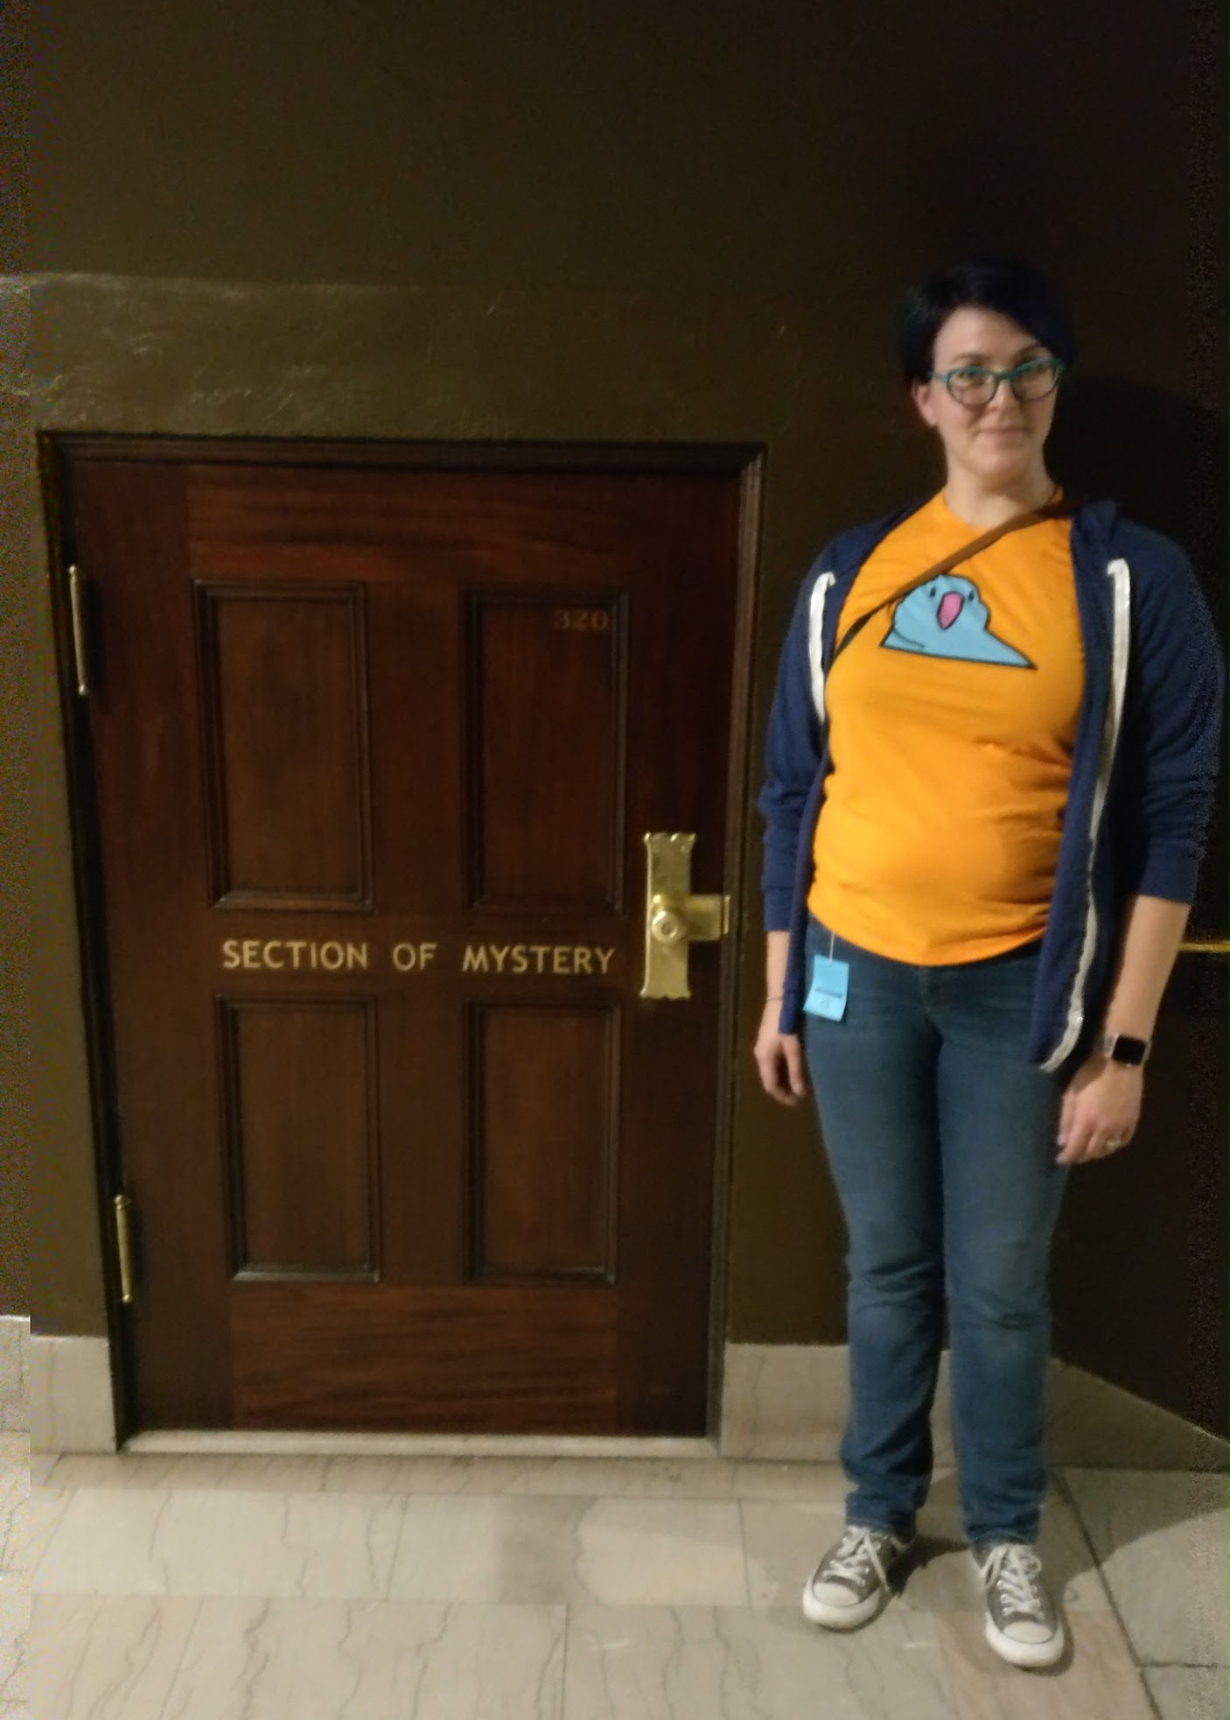

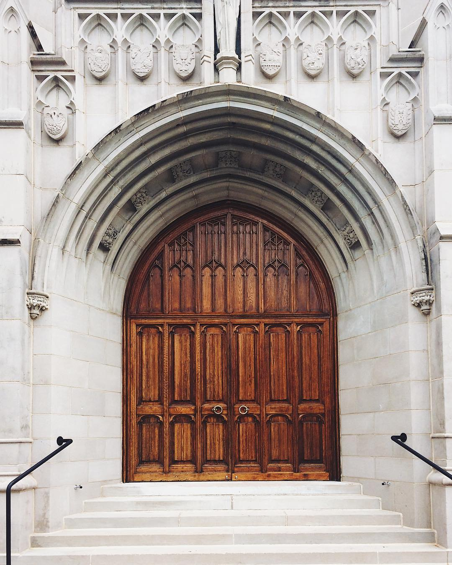
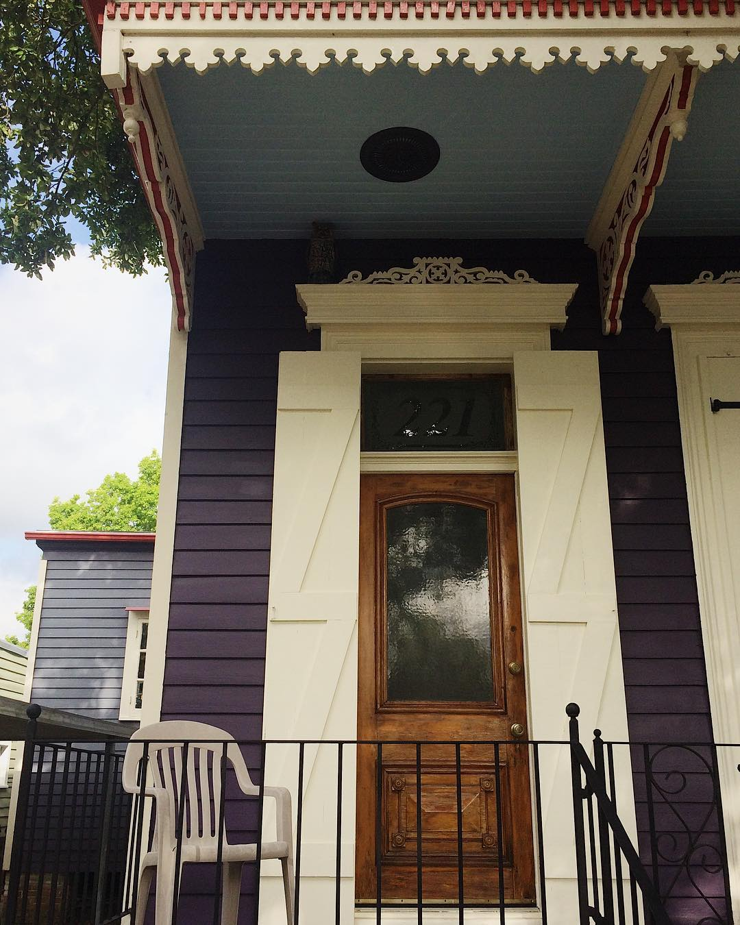




Photos from instagram.com/glynnisritchie and of @bergfulton

Slide 4
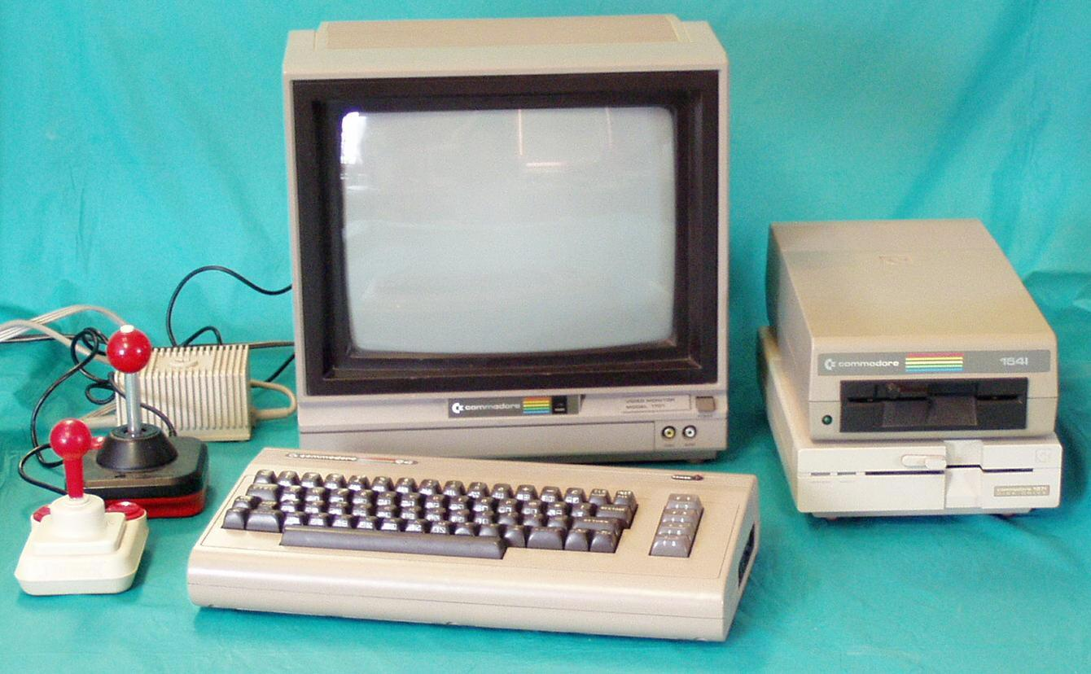
Commodore 64

Slide 5


Slide 6


Slide 7


Slide 8


Slide 9


Slide 10
DOORS!

Slide 11
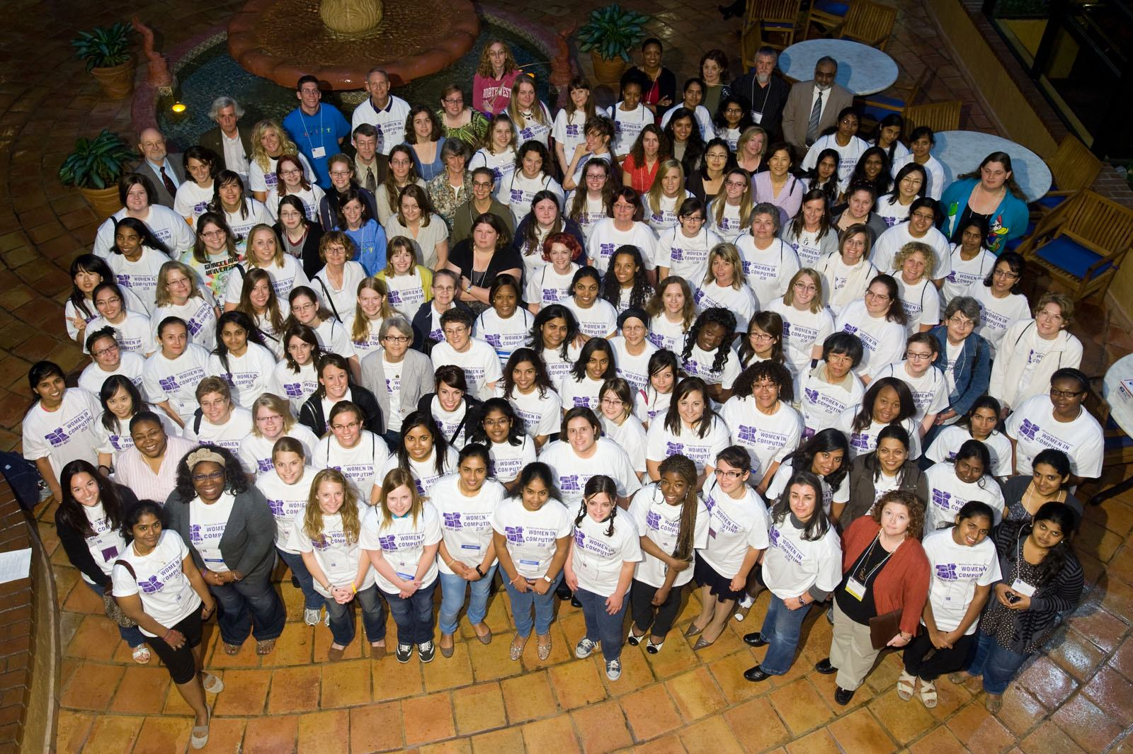

Slide 12
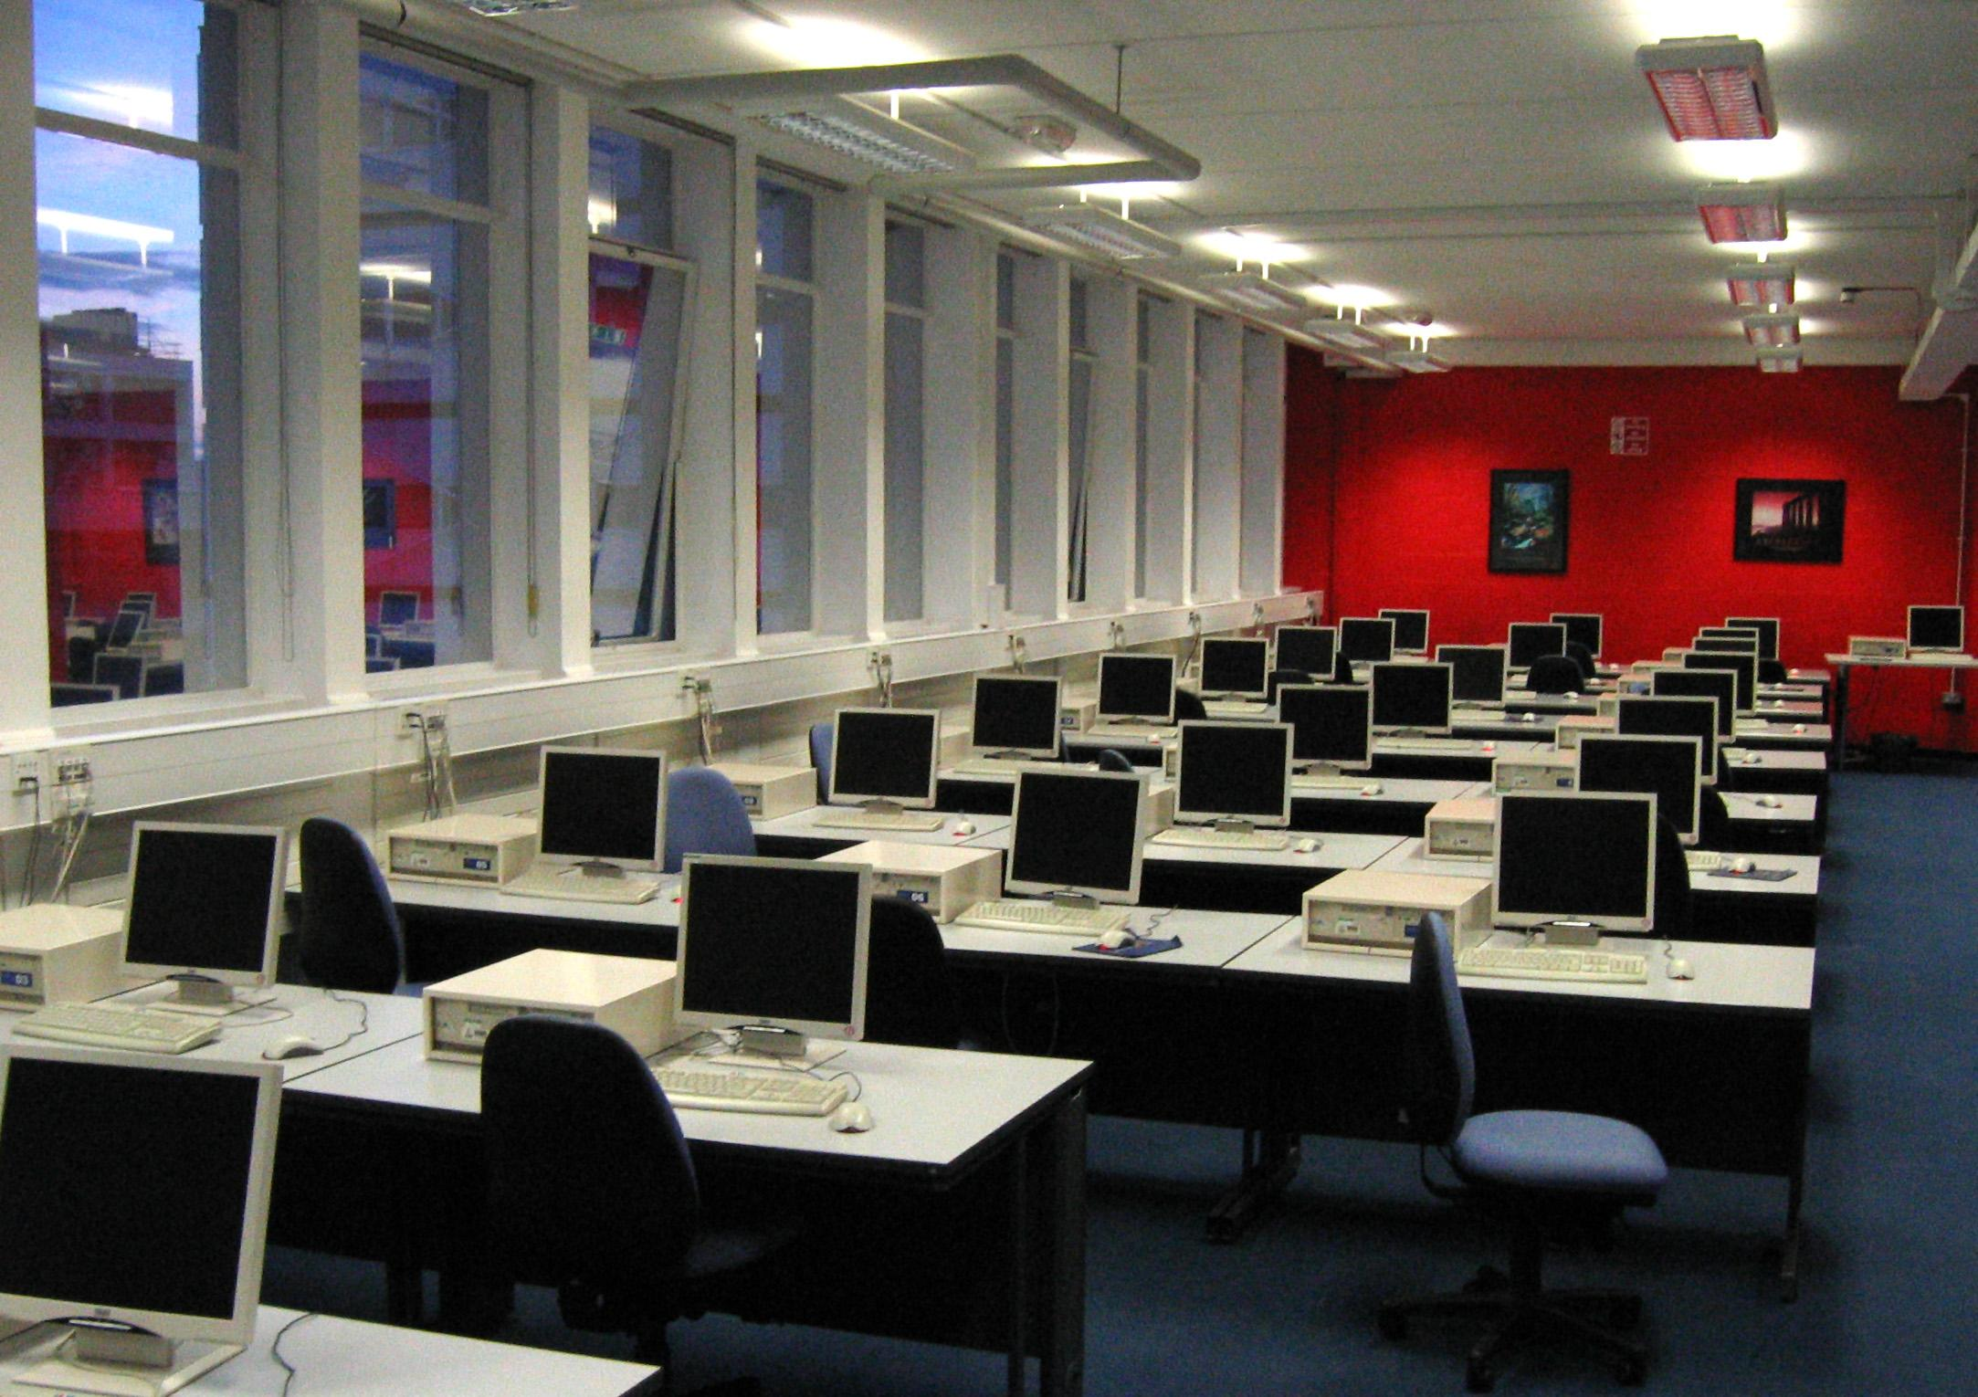

Slide 13
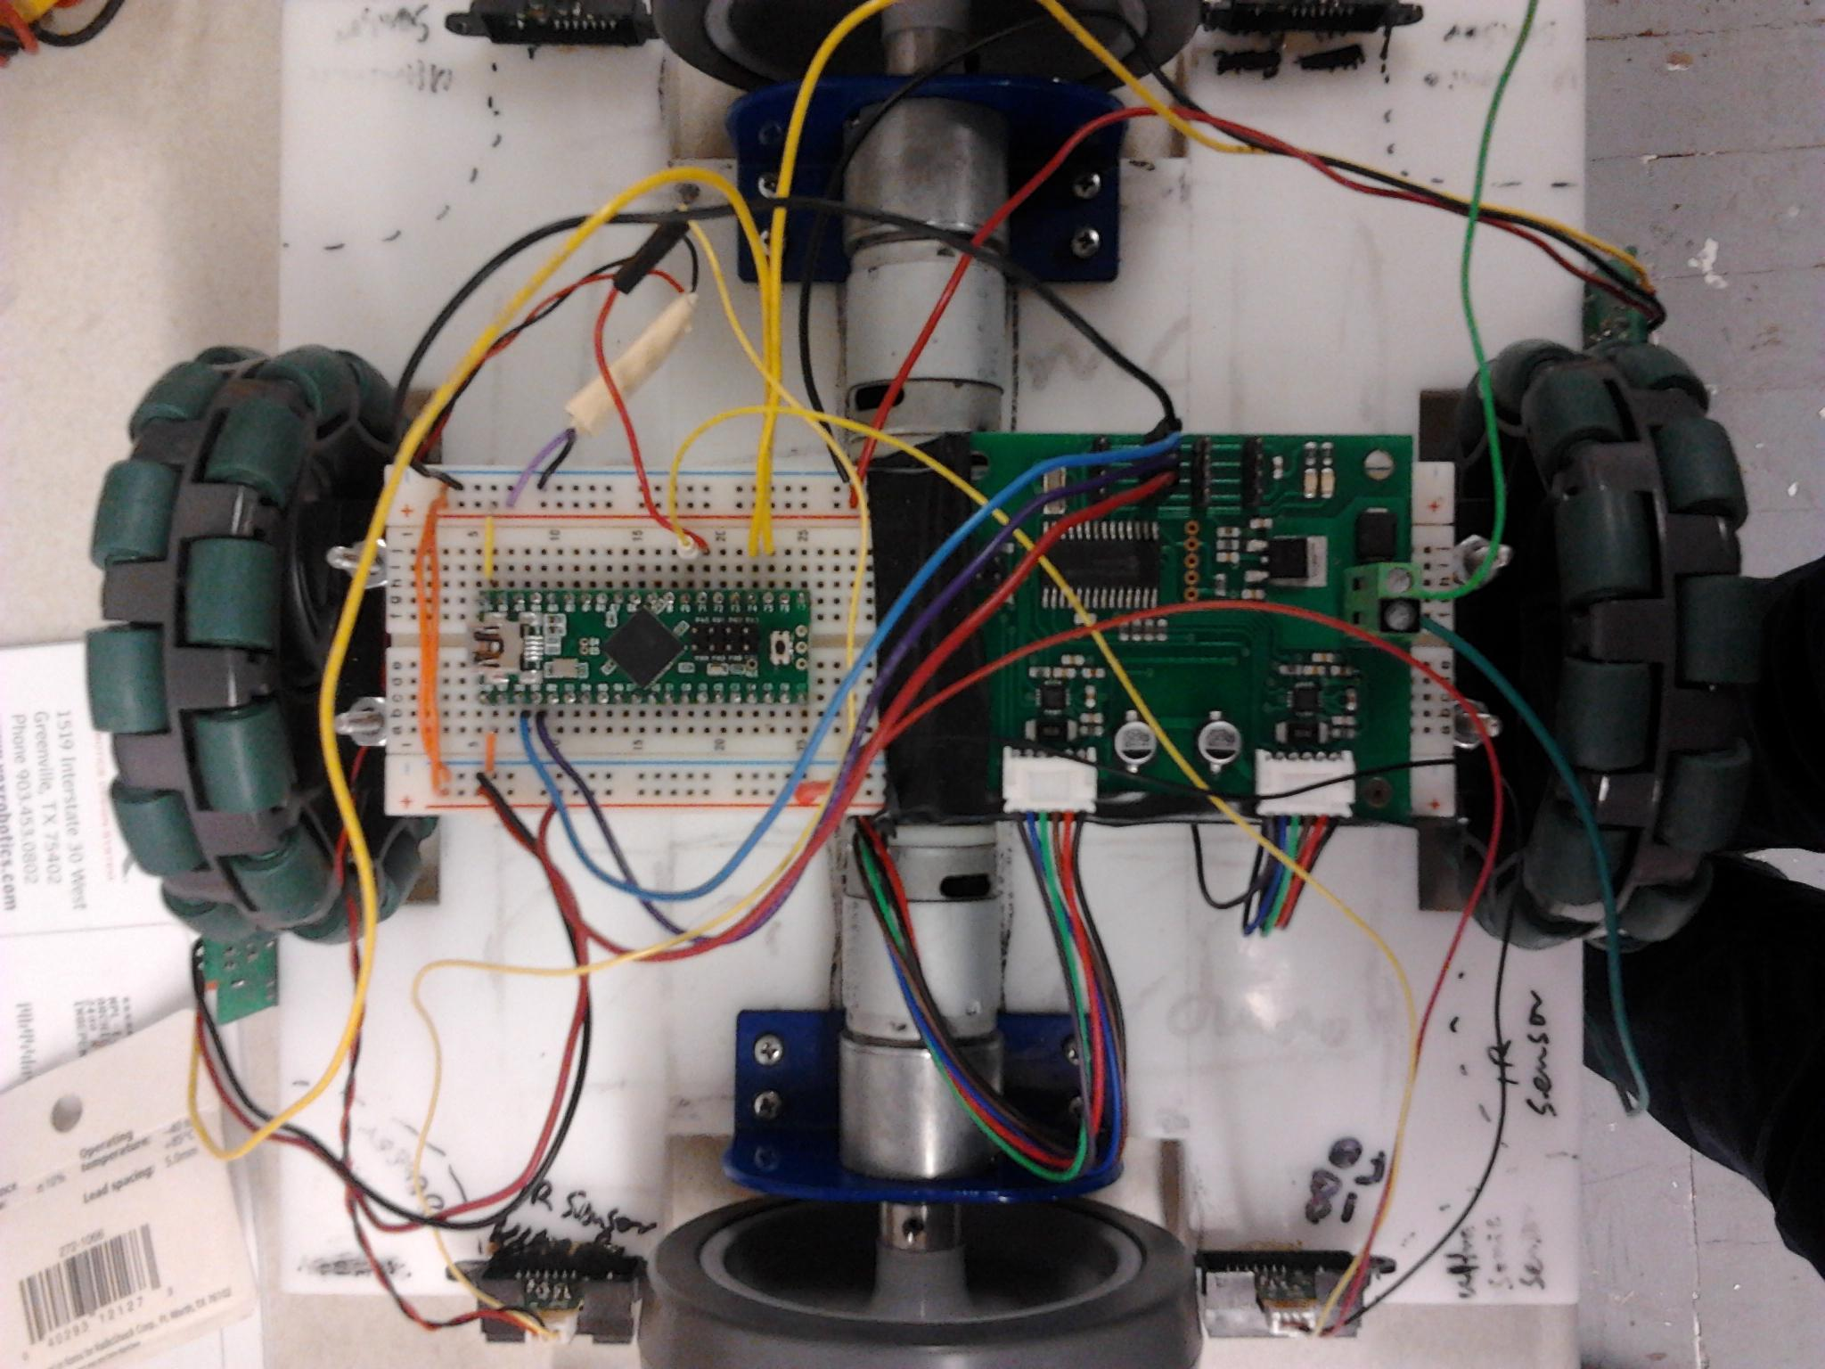

Slide 14
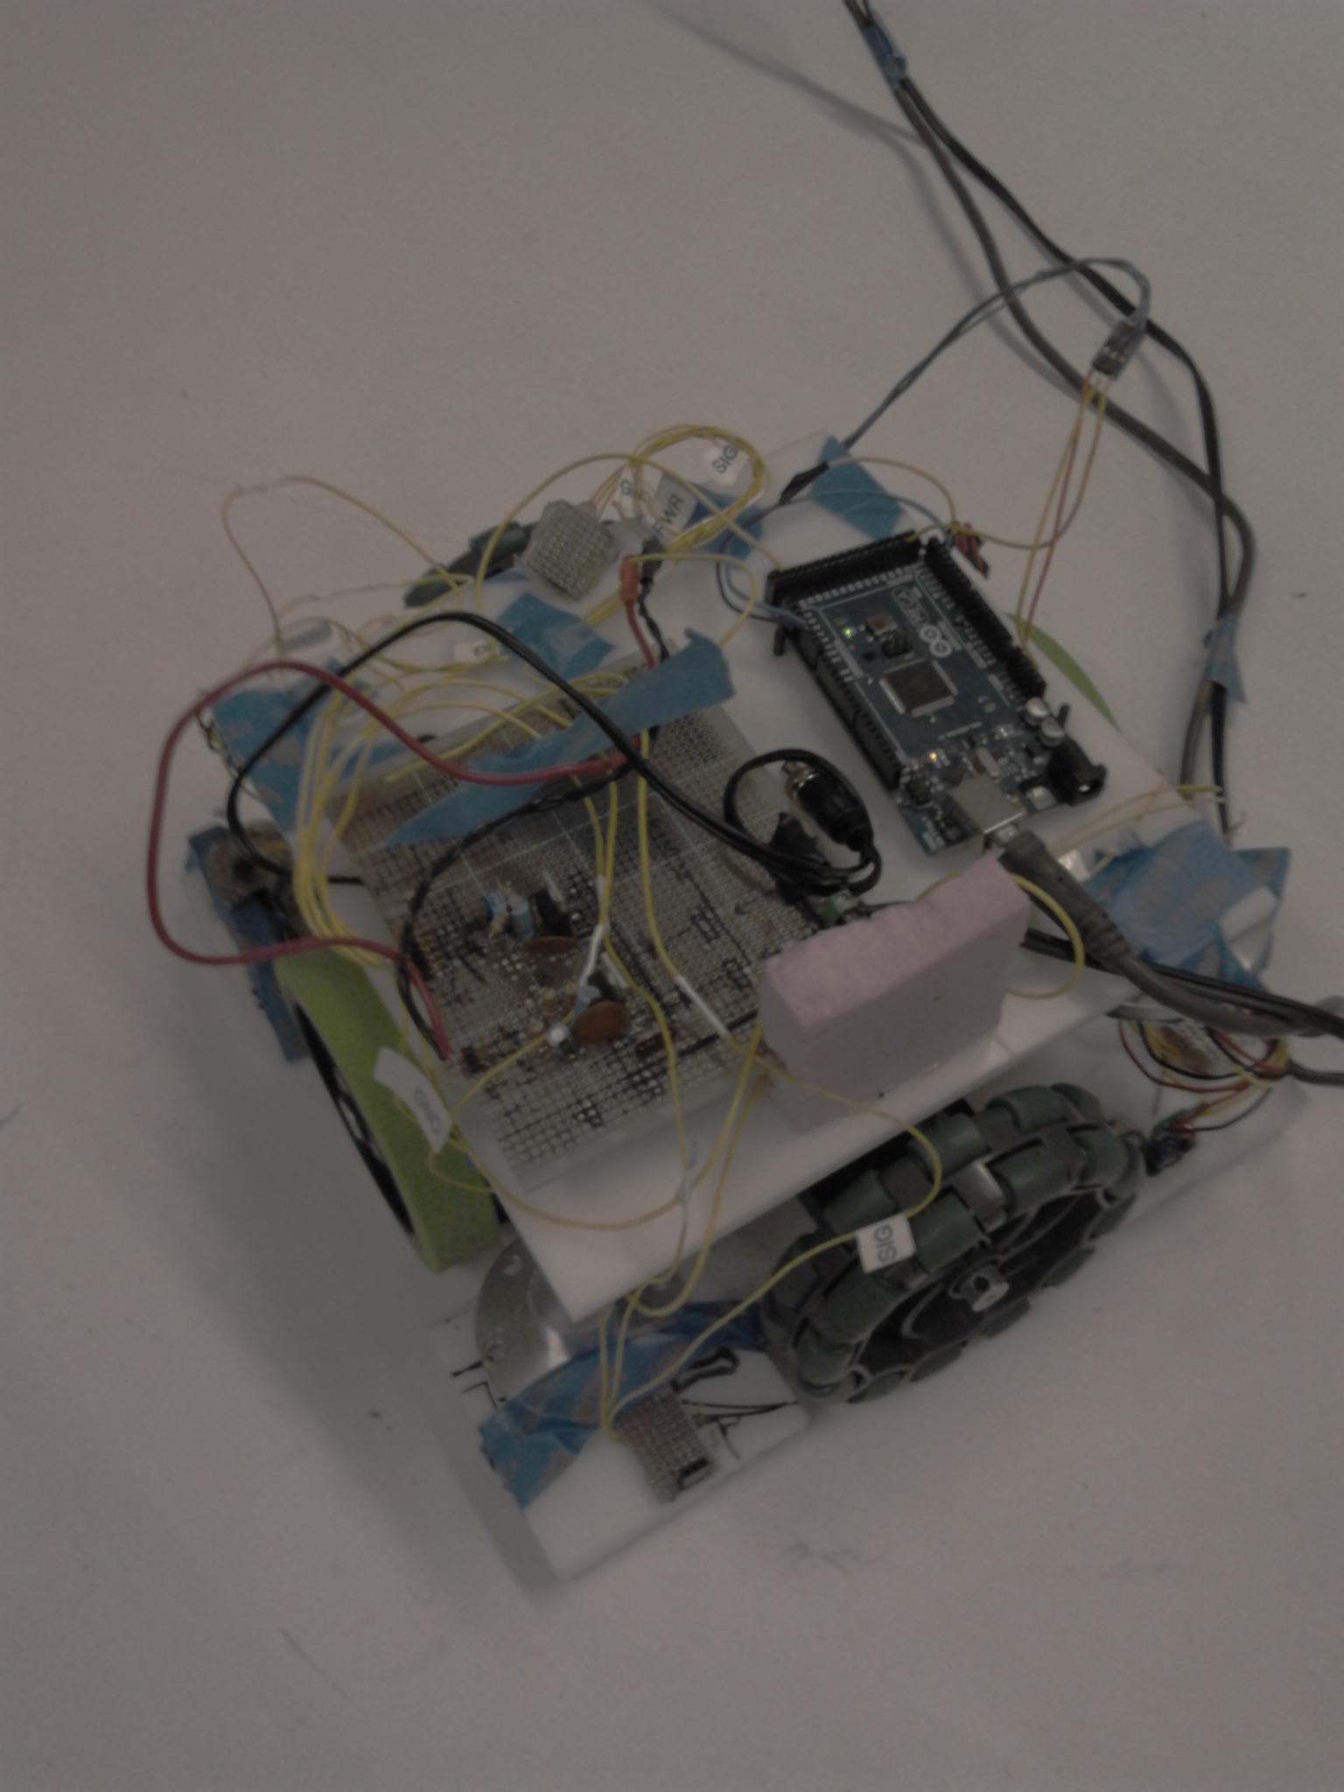
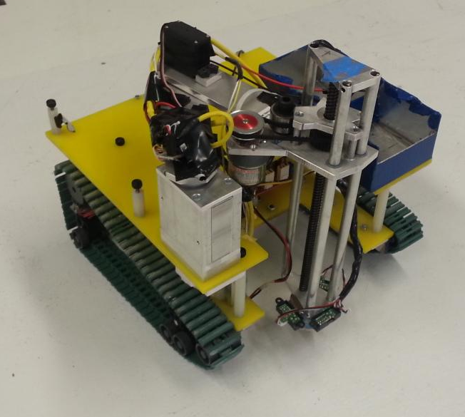
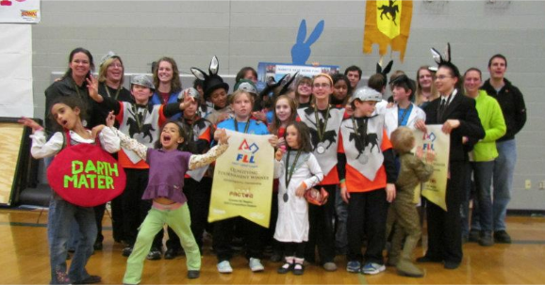

Slide 15
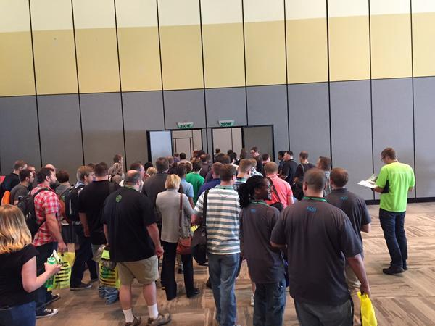

Slide 16
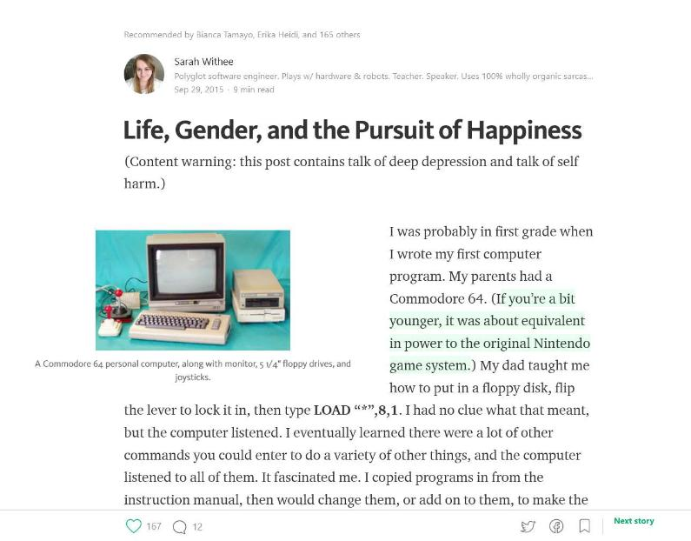

Slide 17


Slide 18
Final Thoughts
Failure will happen (and often). Embrace it!
Get a great support system
Try out those open doors, even if you think you can’t

Slide 19

Credits
Special thanks to…
Presentation template by SlidesCarnival
Door photos by Glynnis Ritchie (instagram.com/glynnisritchie)
My friend Tracey (twitter.com/bergfulton)
Michellege Glauser (twitter.com/michelleglauser)

Slide 20
Thanks!
Any questions?
You can find me at:
@geekygirlsarah
hello@sarahwithee.com
Mingling at this event!

